Slide 1
CM2013: Sleep Scoring Project
Biomedical Signal Processing
Automated Sleep Stage Classification

Slide 2
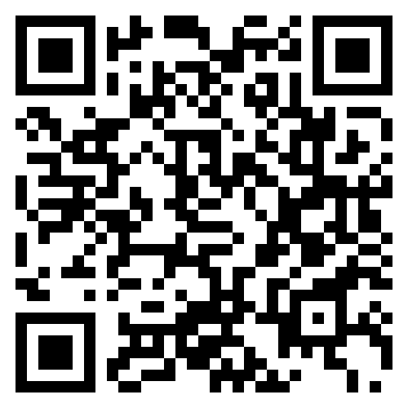
Project Overview
Goal: Develop an automatic sleep scoring system
Multi-signal biosignal processing (EEG, EOG, EMG)
Machine learning classification of 5 sleep stages
Duration: 10-12 weeks with 4 iterations
Team-based development (3-4 members per group)
Deliverables:
Working code (Python/MATLAB)
Technical report (15 pages max)
Project management documentation
https://github.com/farhad-abtahi/CM2013

Slide 3
Learning Objectives
Apply signal processing techniques to real biomedical data
Filtering, artifact removal, feature extraction
Implement machine learning classifiers for pattern recognition
k-NN, SVM, Random Forest
Practice agile software development in teams
Sprints, iterative development, task management
Develop professional documentation skills
Code documentation, technical reports, presentations

Slide 4
Assessment Criteria
Methodology and Code Quality - 50%
Modular design, correct pipeline, documentation, testing
Team Collaboration - 30%
Regular updates, integration, ClickUp usage
Report & Documentation - 20%
Clear technical writing, comprehensive analysis
Note: No fixed accuracy target - focus on process and learning!

Slide 5
Development Methodology:
Agile vs. Waterfall

Slide 6
Waterfall vs. Agile Methodology
Waterfall ❌
Agile ✓ (Our Approach)
• Sequential phases
• No feedback until end
• High risk (all-or-nothing)
• Rigid - difficult to adapt
• Late discovery of issues
• Clear structure upfront
✓ Iterative cycles (sprints)
✓ Feedback after each iteration
✓ Low risk (incremental)
✓ Flexible - adapt to results
✓ Early problem detection
✓ Perfect for research projects

Slide 7
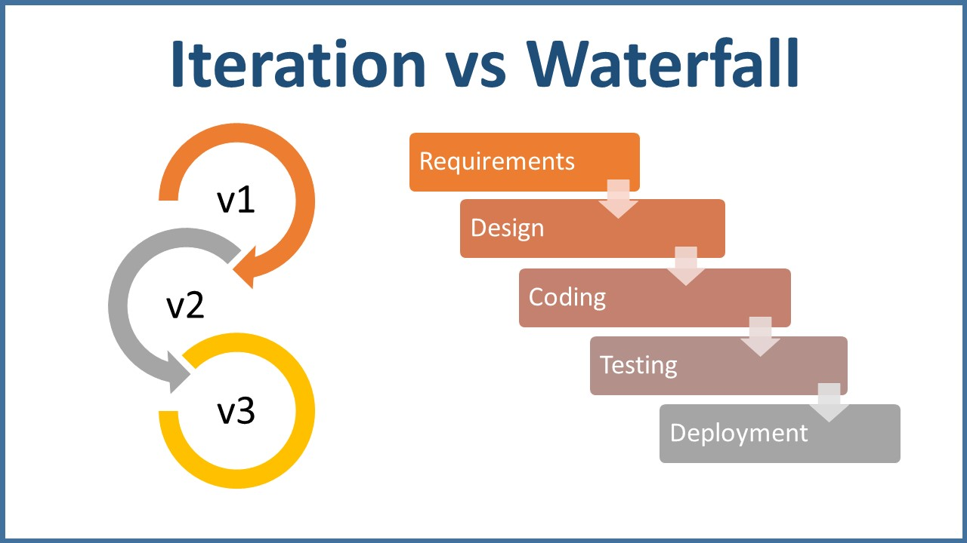
Waterfall vs. Agile Methodology

Slide 8
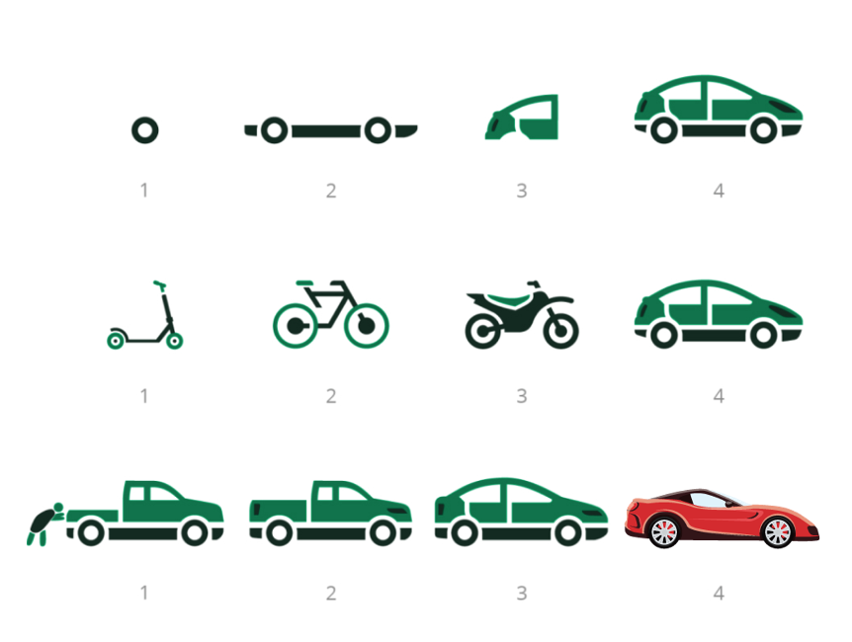
Minimum Valuable Product (MVP)

Slide 9
Sprint Lifecycle (2.5 weeks each)
Day 1-2: Sprint Planning
Day 3-15: Development
Day 16-17: Testing & Integration
Day 18: Sprint Review
Repeat for each of 4 iterations

Slide 10
Iteration Planning:
4 Sprints Over 10 Weeks

Slide 11
Project Timeline - Key Milestones
Iteration 1
Basic EEG
Iteration 2
EEG+EOG
Iteration 3
EEG+EOG+EMG
Iteration 4
Final System
Oct 31, 2025
Nov 19, 2025
Dec 5, 2025
Dec 18, 2025

Slide 12
Iteration Timeline & Milestones
Iteration | Deadline | Signals | Features | Classifier
1 | Oct 31, 2025 | EEG | Time (16) | k-NN
2 | Nov 19, 2025 | EEG+EOG | Time+Freq (31) | SVM
3 | Dec 5, 2025 | EEG+EOG+EMG | Selected (30) | Random Forest
4 | Dec 18, 2025 | All signals | Optimized | RF-optimized

Slide 13
Iteration 1: Basic Pipeline (Oct 31)
Focus: Get something working end-to-end
Signals: EEG only (single or dual channel)
Features: 16 time-domain features per channel
Mean, median, std, variance, RMS, Hjorth parameters
Classifier: k-Nearest Neighbors (k-NN)
Simple, interpretable baseline
Deliverables:
Complete data loading pipeline
Basic preprocessing (filtering, epoching)
Working end-to-end classification

Slide 14
Iteration 2: Enhanced Processing (Nov 19)
Focus: Add EOG and frequency-domain features
Signals: EEG + EOG (eye movement detection)
Features: ~31 features (time + frequency domain)
Add frequency features: band powers, spectral entropy
EOG-specific: eye movement characteristics
Classifier: Support Vector Machine (SVM)
Better handling of high-dimensional data
Deliverables:
Multi-signal processing capability
Frequency-domain feature extraction

Slide 15
Iteration 3: Multi-Signal (Dec 5)
Focus: Add EMG and implement feature selection
Signals: EEG + EOG + EMG (muscle tone)
Features: ~30 selected features (down from 50+)
Feature selection: statistical tests, mutual information
EMG features: muscle activity indicators
Classifier: Random Forest
Handles non-linear relationships, provides feature importance
Deliverables:
Complete multi-signal processing
Intelligent feature selection

Slide 16
Iteration 4: Full System (Dec 18)
Focus: Optimization and finalization
Signals: All available channels optimally combined
Features: Optimized feature set
Cross-validation for robustness
Classifier: Optimized Random Forest
Hyperparameter tuning, ensemble methods
Deliverables:
Final competition submission
Complete technical report
Project documentation and presentation

Slide 17
Project Management:
Using ClickUp

Slide 18
Why Project Management Tools?
Essential for team collaboration and coordination
Track who is doing what and when
Visualize progress and identify blockers
Maintain accountability and transparency
Professional skill development:
Industry standard practice
Critical for remote/distributed teams
Required for assessment (grading checkpoints)
Instructor reviews your ClickUp at each milestone

Slide 19
ClickUp Setup (Project Manager Task)
1. Designate one team member as Project Manager
Role can rotate between iterations
2. Create workspace: CM2013_Sleep_Scoring_Group[X]
3. Add all team members with edit access
4. ⚠️ MANDATORY: Add instructor as viewer
5. Create sprint folders:
Iteration 1: Basic EEG (Due: Oct 31, 2025)
Iteration 2: EEG+EOG (Due: Nov 19, 2025)
Iteration 3: EEG+EOG+EMG (Due: Dec 5, 2025)
Iteration 4: Full System (Due: Dec 18, 2025)

Slide 20
Task Organization in ClickUp
Create tags for organization (free version):
Priority: 🔴 HIGH, 🟡 MEDIUM, 🟢 LOW
Signals: #EEG, #EOG, #EMG
Components: #preprocessing, #features, #classification
Status: #BLOCKED, #NEEDS-REVIEW, #BUG
Task workflow:
To Do → In Progress → Review → Testing → Complete
Each task must have:
Clear title: [Component] Specific action
Assignee, due date, priority, description

Slide 21
Daily Standups (via ClickUp)
Each team member posts daily update as task comment:
Format:
"Today: [what I did]
Tomorrow: [what I'll do]
Blockers: [any issues]"
Benefits:
Keep everyone informed without meetings
Identify problems early
Build accountability and momentum
Tag PM if blocked: @mention

Slide 22
ClickUp Grading Checkpoints
Instructor will review your ClickUp at:
✓ October 31, 2025 - Iteration 1 complete
✓ November 19, 2025 - Iteration 2 complete
✓ December 5, 2025 - Iteration 3 complete
✓ December 18, 2025 - Final delivery
What is evaluated:
Task organization and clarity
Regular updates and progress
Team communication and collaboration
Problem-solving and adaptability

Slide 23
Python Jumpstart:
Project Structure & Usage

Slide 24
Python Jumpstart: What's Provided
⚠️ Structure and examples ONLY - not complete solution!
Provided:
Modular project structure (src/ directory)
Configuration system (config.py)
Basic filter example (lowpass at 40Hz)
3 simple features (mean, median, std)
Basic k-NN classifier with train/test split
Caching system for efficiency
Testing framework (pytest)
Google Colab notebook

Slide 25
Python Project Structure
Python/
src/ - Core modules:
data_loader.py - Load EDF/XML files
preprocessing.py - Signal filtering
feature_extraction.py - Extract features
feature_selection.py - Select best features
classification.py - ML classifiers
visualization.py - Plot results
report.py - Generate reports
main.py - Training pipeline orchestration
run_inference.py - Generate predictions
config.py - Central configuration
colab_notebook.ipynb - Run in Google Colab

Slide 26
System Architecture - Data Flow
Data Layer
EDF Files | XML Files | Cache
Processing Layer
Data Loading | Preprocessing | Features | Selection
Intelligence Layer
Classifiers | Evaluation
Output Layer
Results | Visualization | Reports

Slide 27
Configuration System (config.py)
Central control for the entire pipeline
Key settings:
CURRENT_ITERATION (1-4) - Controls which features/algorithms
USE_CACHE (True/False) - Speed up development
File paths - Data directories
Preprocessing parameters - Filter frequencies
Model hyperparameters - Classifier settings
Benefits:
Easy to switch between iterations
Consistent settings across team

Slide 28
Running the Training Pipeline
1. Setup (first time only):
pip install -r requirements.txt
2. Verify setup:
python -m pytest tests/ -v
3. Run training pipeline:
python main.py
4. Run inference (generate submission):
python run_inference.py
Creates submission.csv in data/ directory

Slide 29
Caching System for Efficiency
Why caching?
Preprocessing is slow (minutes per file)
Feature extraction takes time
Don't repeat work during development
How it works:
Results saved to cache/ directory
Automatically reused on next run
Control with USE_CACHE in config.py
When to clear cache:
Changed preprocessing parameters
Modified feature extraction code

Slide 30
Google Colab Notebook
Alternative to local development
File: colab_notebook.ipynb
Features:
No local setup required
Free GPU access (if needed)
Load from GitHub or Google Drive
Run complete pipeline in browser
Usage:
Upload to Google Colab
Follow cell-by-cell instructions
View results inline

Slide 31
What You Must Implement
Iteration 1:
Real EDF/XML file parsing
Bandpass filtering (0.5-40 Hz)
13+ additional time-domain features
Iteration 2:
Multi-channel processing (EEG+EOG)
Frequency-domain features (band powers)
SVM hyperparameter tuning
Iteration 3:
EMG signal processing
Feature selection algorithms
Iteration 4:
Cross-validation, optimization, final report

Slide 32
Final Report:
Structure & Requirements

Slide 33
Technical Report (15 pages max)
1. Introduction (1 page)
Problem statement, objectives
2. Methods (3 pages)
Signal processing, features, classification
3. Results (4-5 pages)
Performance metrics, confusion matrices, analysis
4. Discussion (3-4 pages)
Interpretation, challenges, improvements
5. Conclusion (1 page)
Summary, future work
6. References (1 page)

Slide 34
Report Content Focus
Focus on the process, not just results
Methods section should explain:
WHY you chose specific approaches
HOW you implemented them
What alternatives you considered
Results section should show:
Progression through iterations
Impact of different decisions
Statistical analysis of performance
Discussion should reflect:
Critical thinking about your approach
Learning from what didn't work

Slide 35
Data & File Formats

Slide 36
Data Organization
data/training/ - EDF + XML files with labels
Use for training and validation
Both EDF and XML required for each recording
data/holdout/ - EDF files only (no labels)
Use for final predictions/competition
data/sample/ - Small test dataset
Quick testing during development
Key signals in EDF files:
EEG: C3-A2, C4-A1 (125 Hz, hardware high-pass 0.15 Hz)
EOG: Left/Right (50 Hz, hardware high-pass 0.15 Hz)
EMG: (125 Hz, hardware high-pass 0.15 Hz)
ECG: (125 Hz), Respiration: Thor/Abdo (10 Hz), SpO2/HR (1 Hz)

Slide 37
Available Signals - Detailed Specifications
Signal | EDF Label | Sample Rate | Hardware Filter
EEG C3-A2 | EEG (sec) | 125 Hz | HP 0.15 Hz
EEG C4-A1 | EEG | 125 Hz | HP 0.15 Hz
EOG Left | EOG(L) | 50 Hz | HP 0.15 Hz
EOG Right | EOG(R) | 50 Hz | HP 0.15 Hz
EMG | EMG | 125 Hz | HP 0.15 Hz
ECG | ECG | 125 Hz | HP 0.15 Hz
Thorax RES | Thor RES | 10 Hz | HP 0.05 Hz
Abdomen RES | Abdo RES | 10 Hz | HP 0.05 Hz
SpO2 | SaO2 | 1 Hz | -
Heart Rate | H.R. | 1 Hz | -

Slide 38
EDF and XML File Formats
EDF (European Data Format):
Standard for biosignals (EEG, EOG, EMG)
Multiple channels with metadata
Python: Use MNE library (mne.io.read_raw_edf)
XML (Compumedics Annotation Format):
Sleep stage labels for each 30-second epoch
Stages: Wake, N1, N2, N3, REM
Python: Use xml.etree.ElementTree
📚 Reference: github.com/nsrr/edf-editor-translator/wiki

Slide 39
Signal Processing Considerations
Hardware Filtering Already Applied:
EEG/EOG/EMG/ECG: High-pass 0.15 Hz
Respiration: High-pass 0.05 Hz
Design additional filters accordingly
Different Sampling Rates:
Primary signals (EEG/EMG/ECG): 125 Hz
EOG signals: 50 Hz
Respiration/Airflow: 10 Hz
SpO2/Heart Rate: 1 Hz
30-second epochs = different sample counts per signal

Slide 40
Tips for Success

Slide 41
Tips for Success
Start early and work consistently
Don't wait until deadlines
Code first, optimize later
Get something working, then improve
Test often - run pipeline after changes
Use caching to speed up development
Document as you go - not at the end
Communicate proactively with your team
Over-communication is better than under-communication
Ask for help early when stuck
Celebrate wins and learn from failures

Slide 42
Team Organization (3 members)
Project Manager:
Coordination, ClickUp, integration, documentation
Preprocessing Lead:
Signal cleaning, filtering, artifact removal
Feature Engineer:
Feature extraction, selection, analysis
Note: With 3 members, roles overlap!
Everyone should contribute to multiple areas
Cross-train and help each other
ML/classification can be shared responsibility

Slide 43
Resources & Documentation
Project documentation:
PROJECT_GUIDE.md - Complete project guide
CLAUDE.md - Codebase overview
Python/README.md - Python jumpstart guide
Key libraries:
MNE - EEG/biosignal processing
scikit-learn - Machine learning
NumPy/SciPy - Signal processing

Slide 44
Guidelines for Contacting the Teaching Team
Support Team
Farhad Abtahi, sabt@kth.se (CC)
Fardin Afdideh, fardia@kth.se (main contact)
Eduardo Illueca Fernandez, eduardo.illueca@ki.se (CC)

Slide 45
Guidelines for Contacting the Teaching Team
⁠Primary Contact Method
Use email.
Clearly include: [Course Code] + [Topic] in the subject line.
⁠Before Contacting
Re-check lecture slides, assignments, forum, and FAQs
Booked Sessions
Come prepared with specific questions or code snippets — not just “I don’t understand.”

Slide 46
Guidelines for Contacting the Teaching Team
Email Etiquette
Be concise but include enough detail (assignment number, error messages, screenshots).
Avoid last-minute emails right before deadlines.
Group Support
If several students have the same question, we may answer it once on the forum instead of multiple emails.
Workload Balance
TAs are here to help, not to solve assignments for you.
Please attempt the problem first and show your work when asking for help.

Slide 47
Questions?

Slide 48
Summary - Key Takeaways
✓ Iterative agile development over 10 weeks
✓ 4 sprints with clear milestones and deadlines
✓ Assessment based on process, not just accuracy
✓ Use ClickUp for project management and collaboration
✓ Python jumpstart provides structure, you implement algorithms
✓ Focus on learning and continuous improvement
Start with Iteration 1: Get basic pipeline working!
Good luck! 🚀

